Slide 1
The Impact of COVID-19 on U.S. Housing Prices
Ed Shanks, Ali Bridgers, Harrison Riebow

Slide 2
Overview
In the early months of 2020, the onset of the COVID-19 pandemic triggered a number of macroeconomic shifts across the world. These included challenges with:
supply chain logistics
rising inflation rates
unemployment
economic downturn
For our analysis we chose to examine another notable macroeconomic impact that occurred during this time:
increase in housing prices

Slide 3
Project Objective
Using the Nasdaq Zillow API as our data source, we chose to focus on U.S. metro areas, which encompass a wide range of socioeconomic groups, residents and single family homes. The Nasdaq Zillow API offers a range of time series and metrics to track U.S. housing markets. We chose to use the Average Monthly Sales Price of Single Family Homes in a Given Metro Area, hereinafter referred to as Monthly Sales Price.
With that data, we will determine how much home prices increased after the beginning of the covid pandemic.

Slide 4
Understanding the Problems
How much did home prices increase after the beginning of the COVID-19 pandemic?
Did any U.S. real estate markets experience an abnormally sharp increase in home prices?
Is there any correlation between the geographic location of a real estate market and the rate at which home prices accelerated in that market?

Slide 5
How much did home prices increase after the beginning of the COVID-19 pandemic?
Metro Areas:
New York, Los Angeles, Miami, St. Louis, Seattle, Atlanta, Houston, and Minneapolis
Timeframe:
2017 - 2022
Price Metric:
Average Monthly Sales Price of Single Family Homes in a Given Metro Area (A.K.A: Monthly Sales Price)
Let’s look at some data:

Slide 6
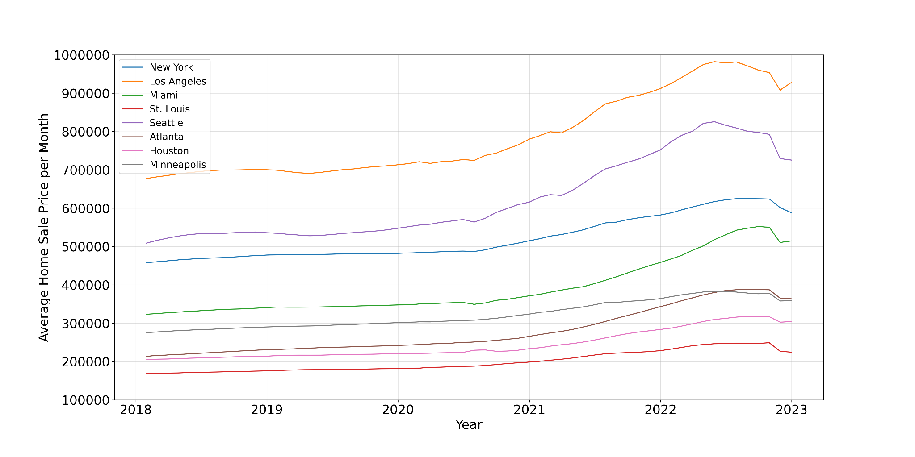
To visualize the trends over time, we plotted the monthly sales prices for each city on the same graph. The resulting analysis reveals...

Slide 7
Monthly Sales Price for Each Metro Area Plotted Individually
As the previous graph shows, it appears each Metro Area in our data set began increasing during the COVID-19 pandemic. We graphed the increase for each Metro Area individually to dig further into the data.
We broke each plot down into two time periods:
2017 - 2019 (pre COVID-19), shown in blue
2020 - 2022 (during COVID-19), shown in orange

Slide 8
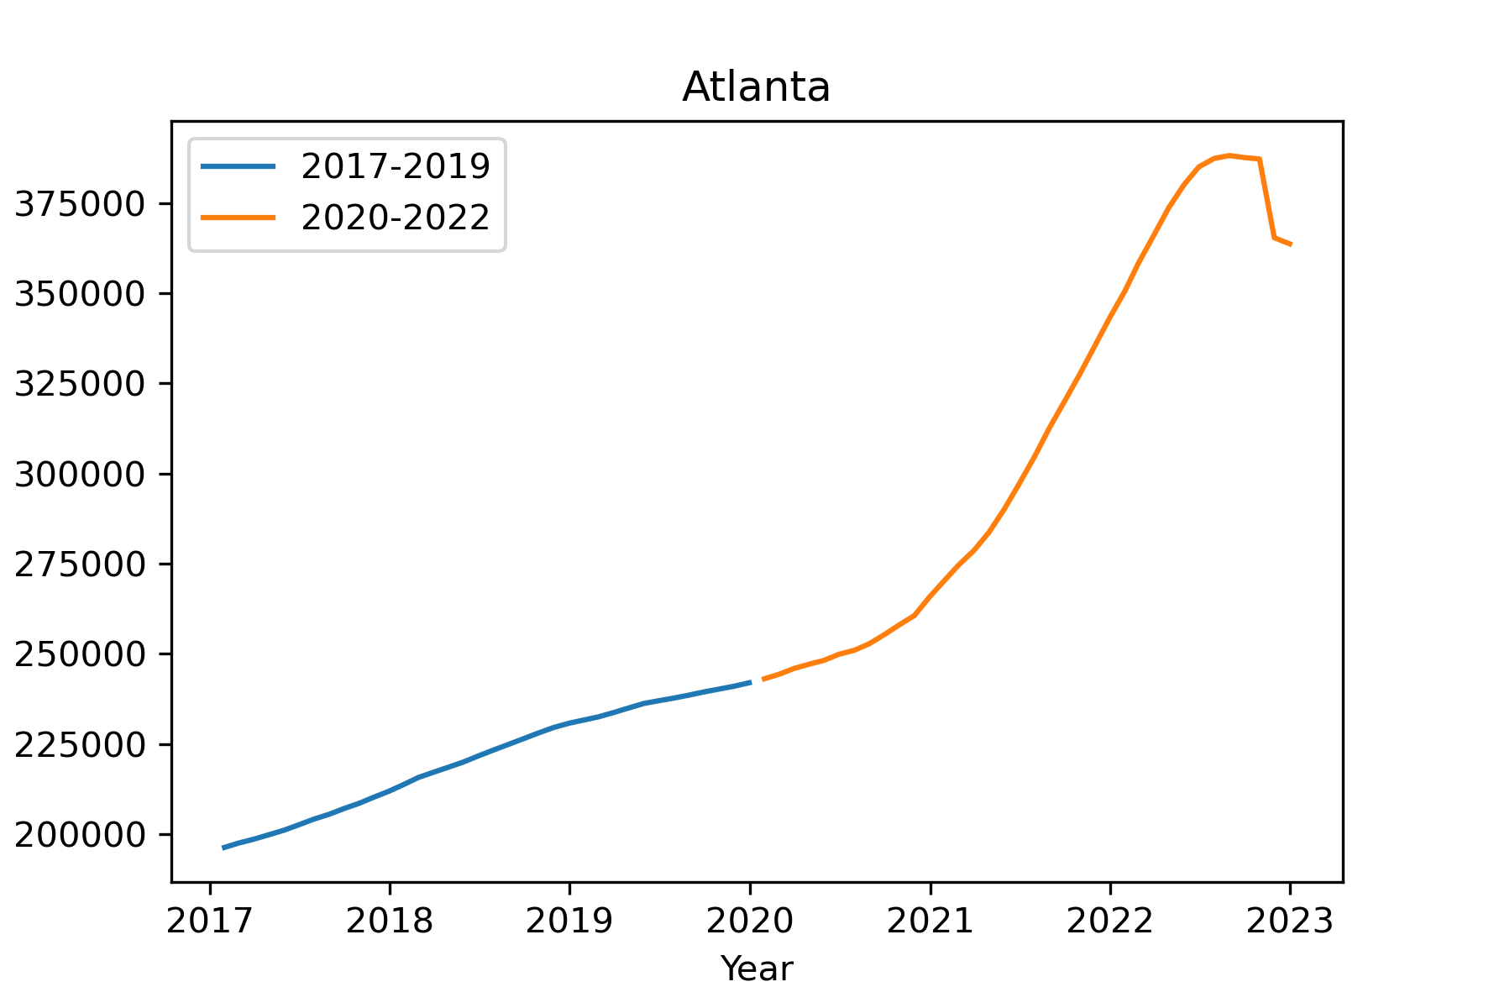
Average Home Sale Price by Month

Slide 9
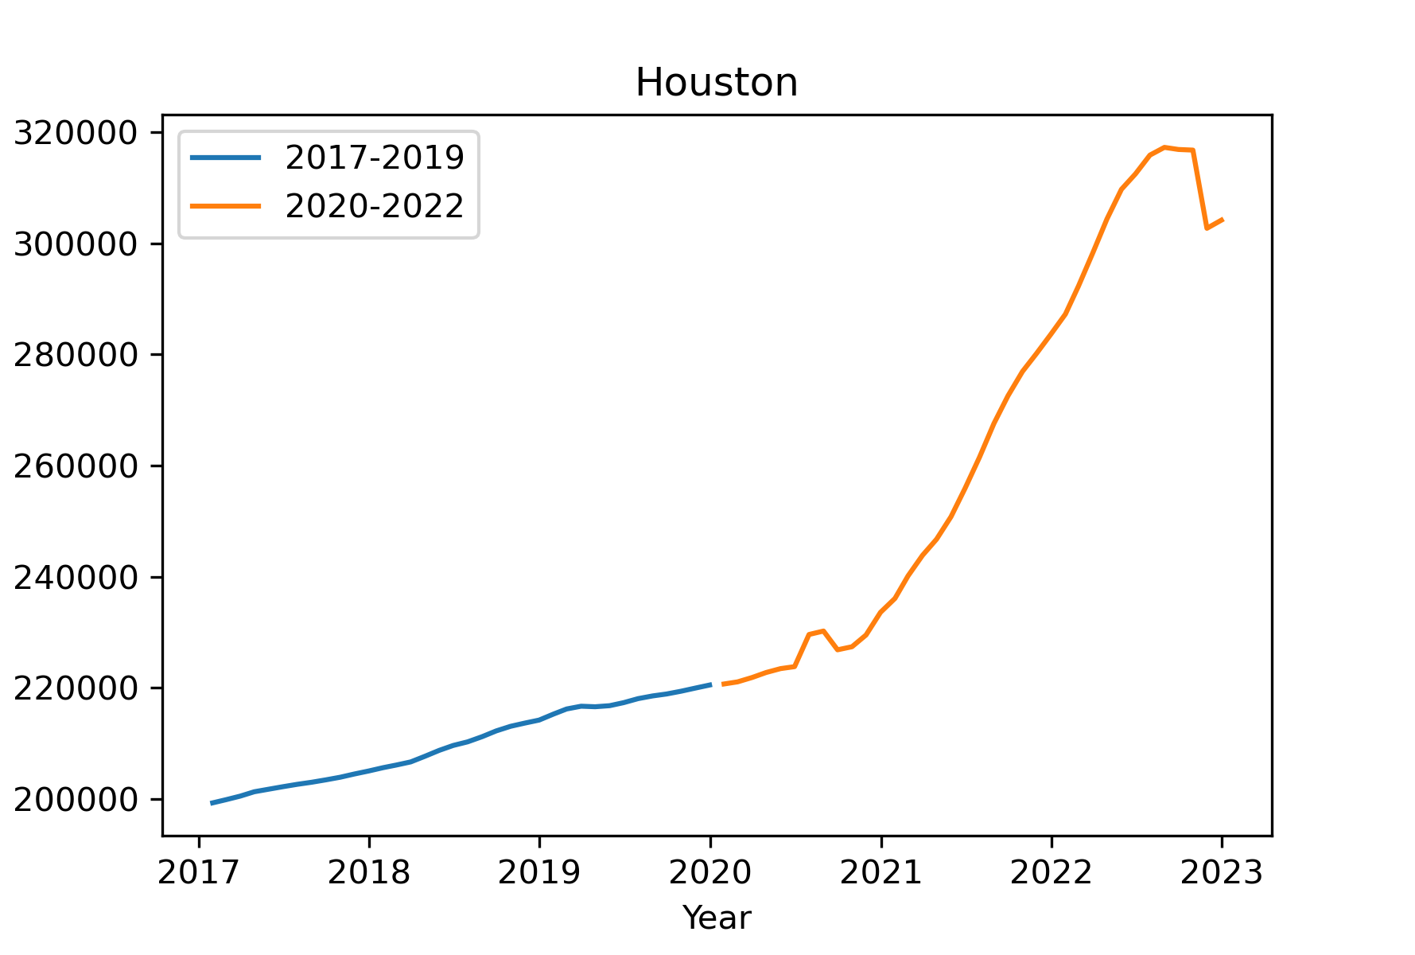
Average Home Sale Price by Month

Slide 10
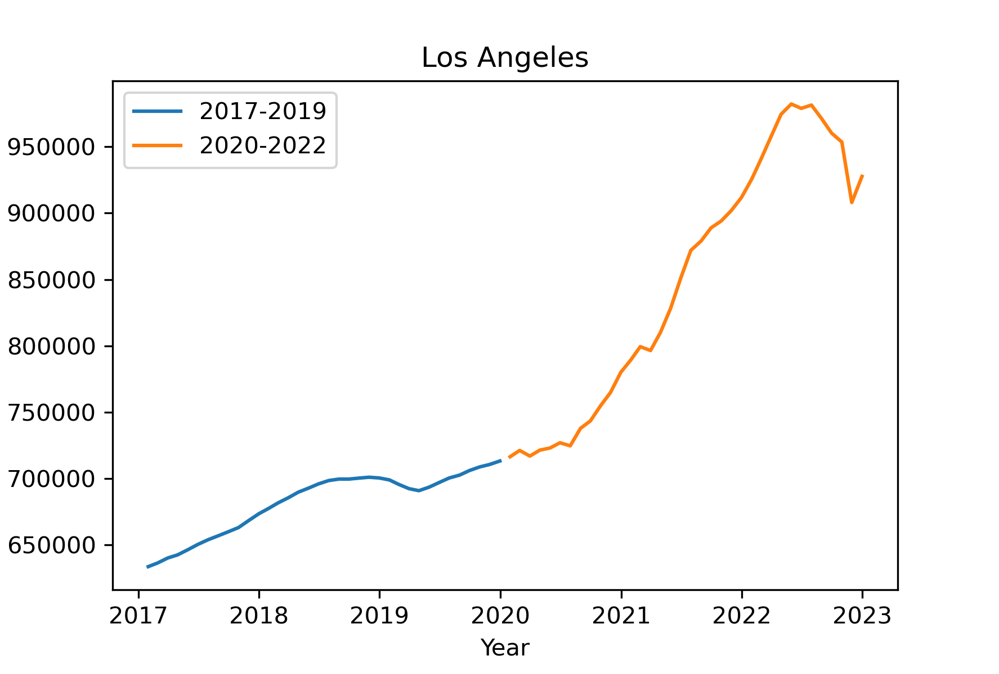
Average Home Sale Price by Month

Slide 11
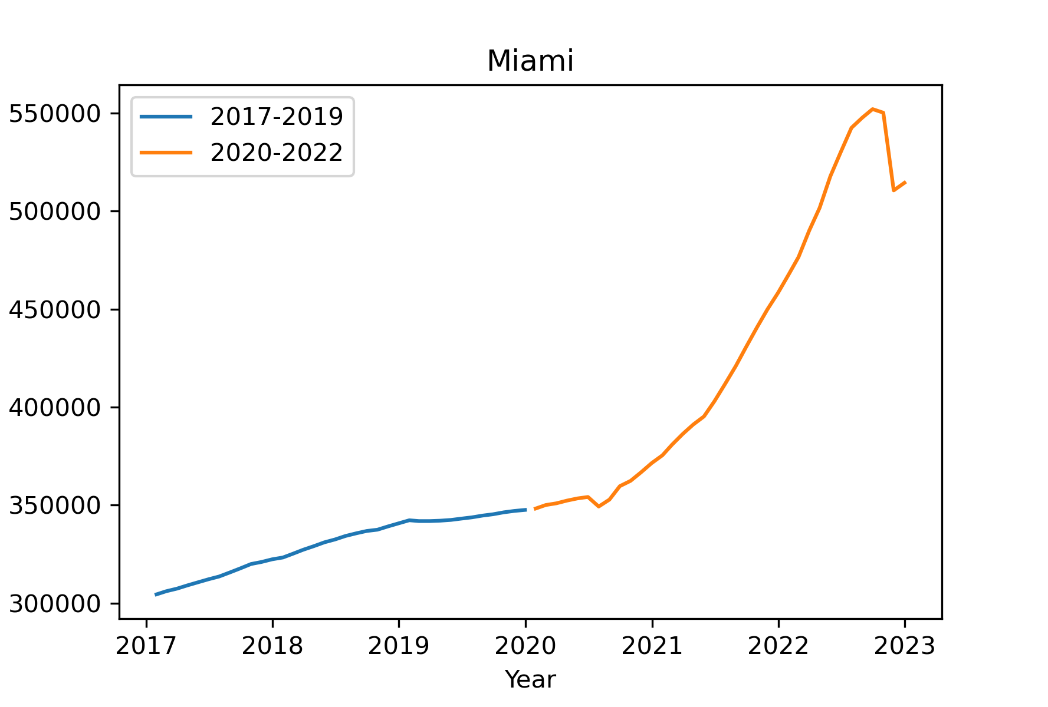
Average Home Sale Price by Month

Slide 12
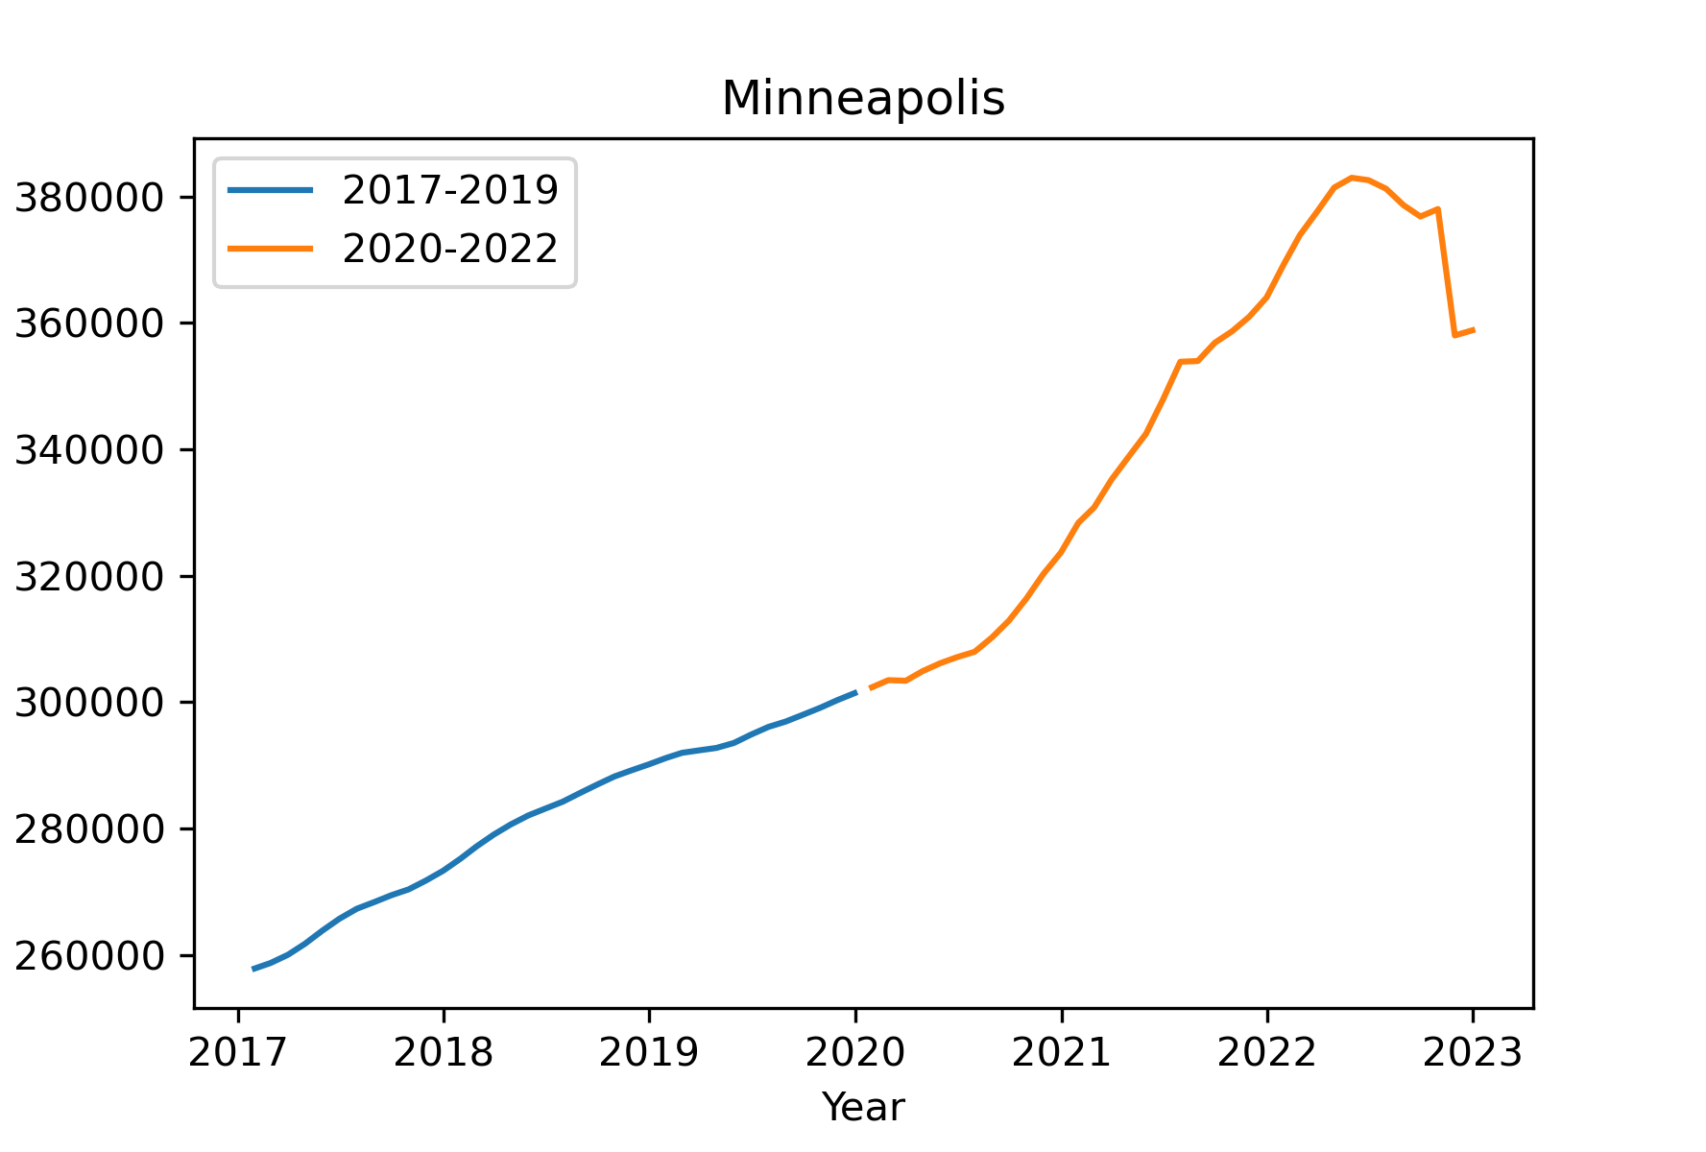
Average Home Sale Price by Month

Slide 13
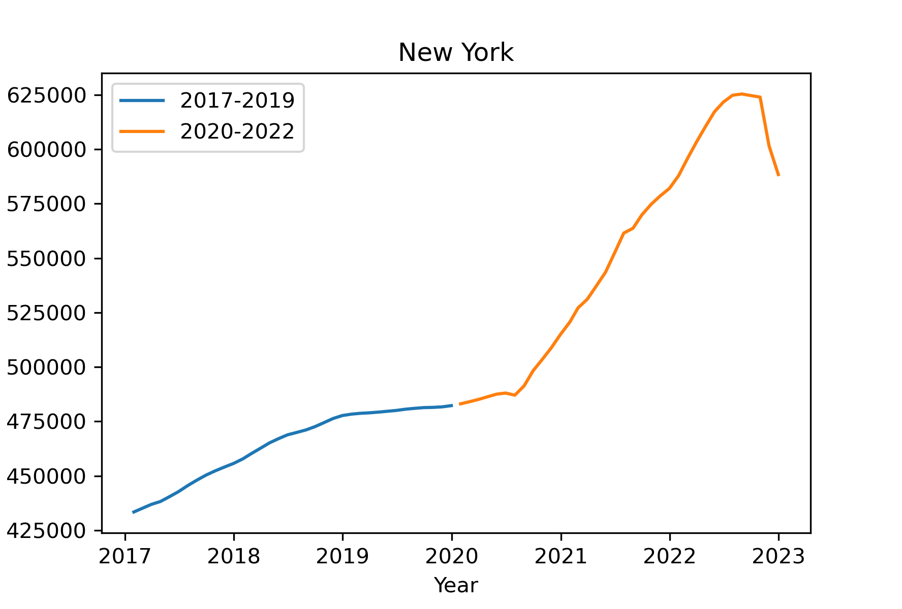
Average Home Sale Price by Month

Slide 14
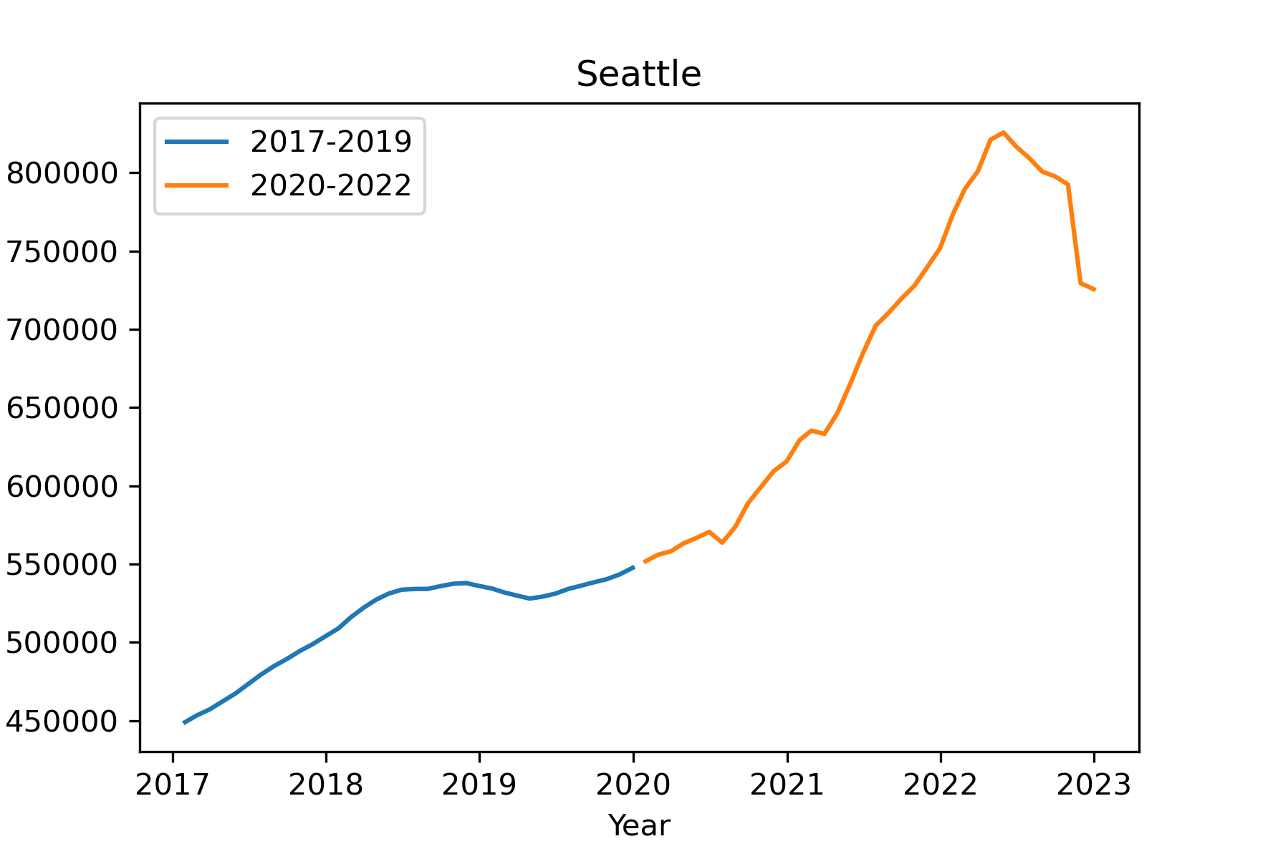
Average Home Sale Price by Month

Slide 15
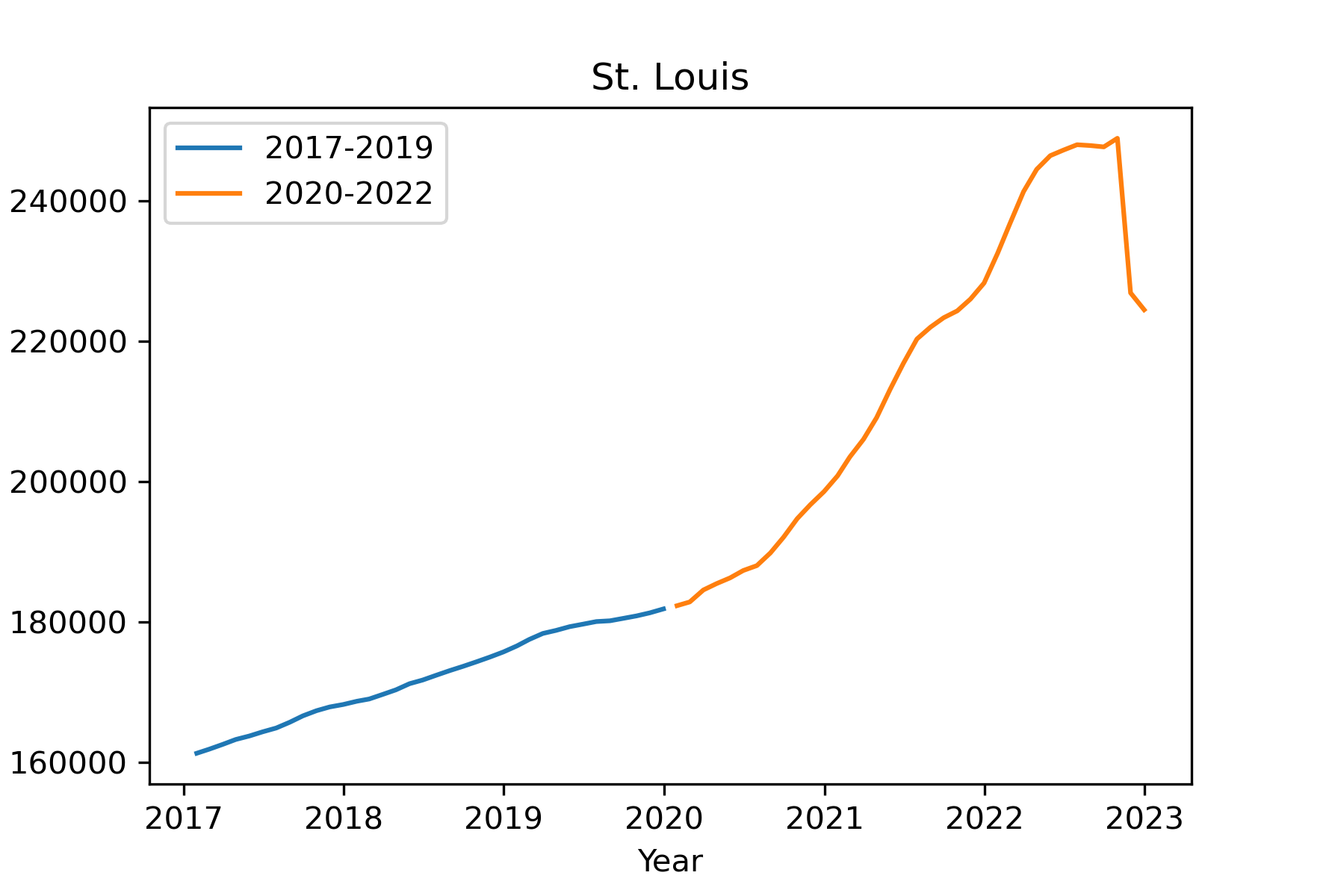
Average Home Sale Price by Month

Slide 16
What stands out…
The monthly sales price increases at a much faster rate during the time of COVID-19.
All U.S. Metros studied followed the same trend with prices abruptly going up starting in 2020, before dipping around the end of 2022.

Slide 17
Did any US real estate markets experience an abnormally sharp rise in home prices?
Metro areas:
New York, Los Angeles, Miami, St. Louis, Seattle, Atlanta, Houston, Minneapolis, Chicago, Nashville, New Orleans, Bozeman, Boise, Dallas-Fort Worth, San Diego, Portland, Detroit, Philadelphia, Boston, Charleston, Cincinnati, Omaha, Las Vegas, Salt Lake City, Denver, Phoenix, Austin, Kansas City, Tampa, Cleveland, Milwaukee, Charlotte, Washington D.C., Albuquerque, Baltimore, Pittsburgh
Timeframe:
2017 - 2022
Price Metric:
Average Monthly Sales Price of Single Family Homes in a Given Metro Area, Percent Change (A.K.A Price Acceleration)

Slide 18
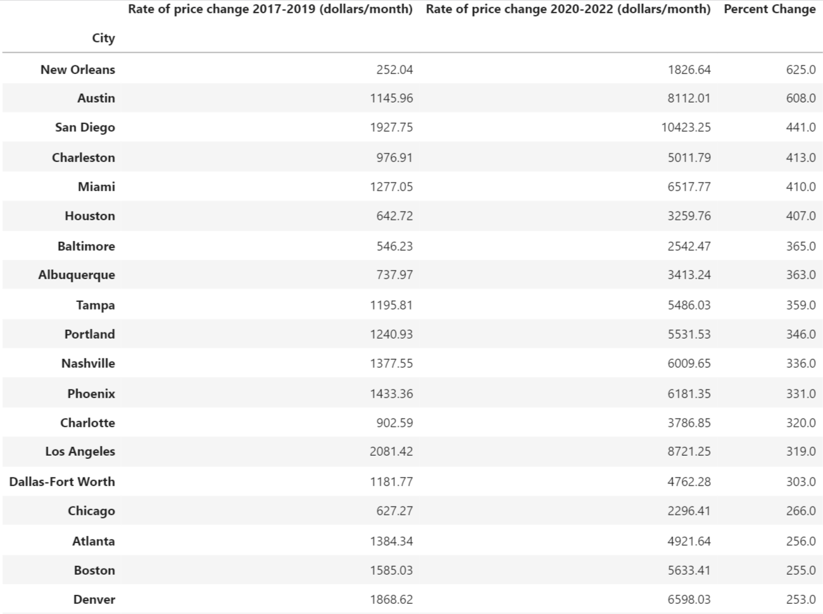

Slide 19
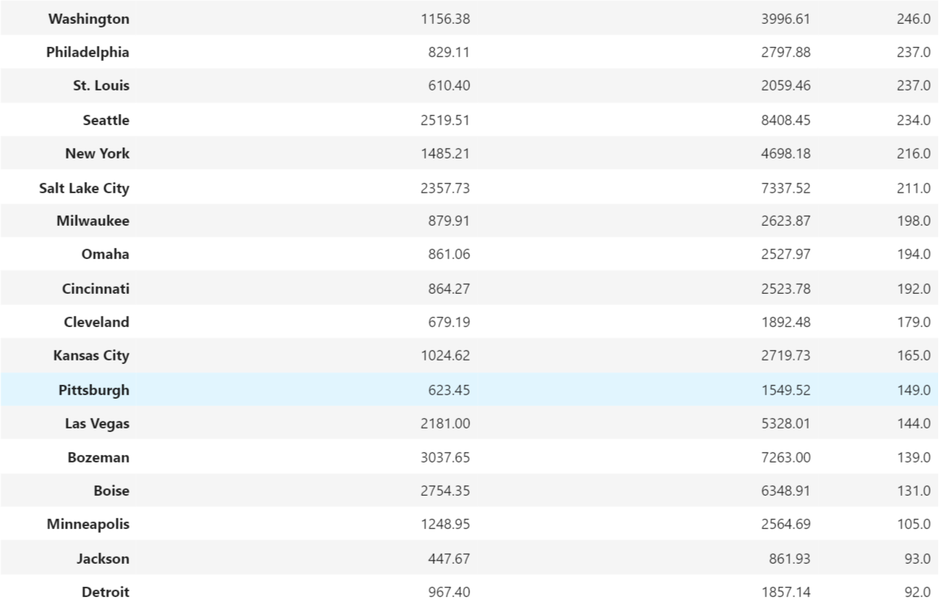

Slide 20
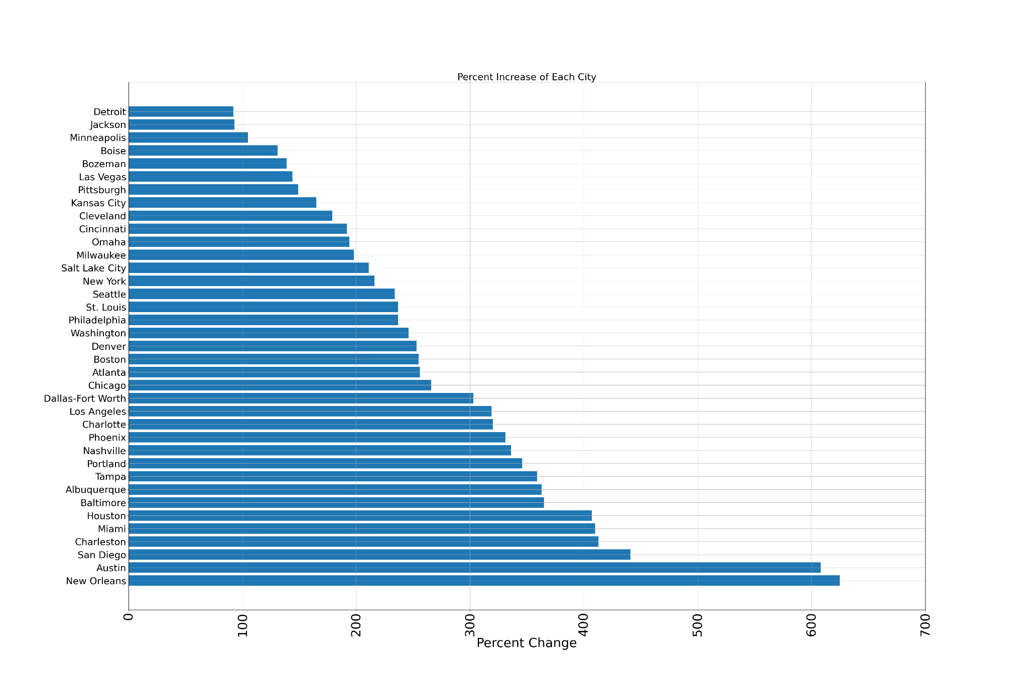
Percent Increase of Each City

Slide 21
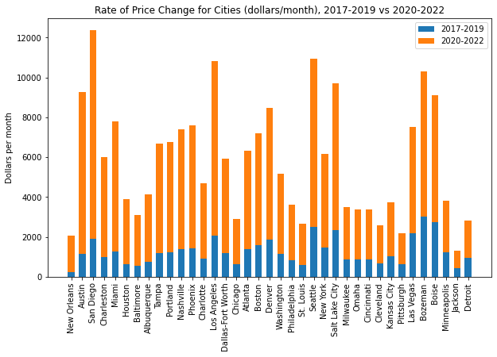
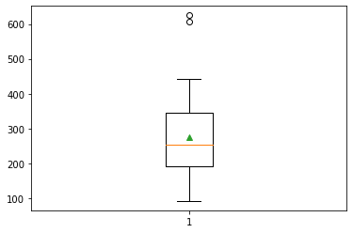
Outliers
New Orleans (625.0%)
Austin (608.0%)

Slide 22
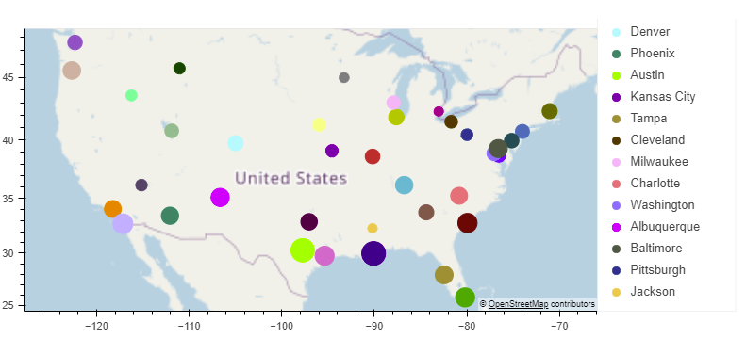
https://sites.google.com/view/mapplot/home

Slide 23
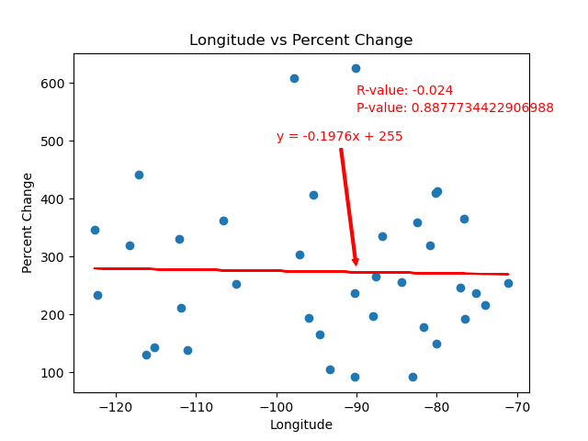
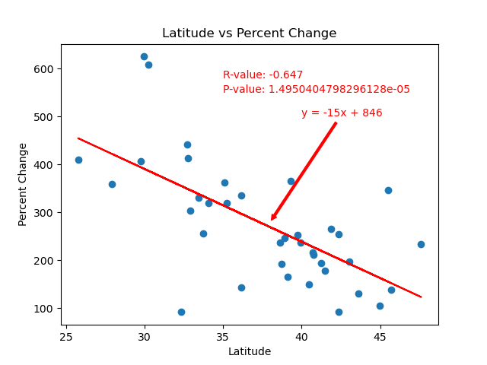
Is there any correlation between the geographic location of a real estate market and the rate at which home prices accelerated in that market?

Slide 24
Conclusions
Based on our analysis, home prices increased sharply across the country during the COVID-19 pandemic.
Some metropolitan areas experienced an abnormally sharp rise in home prices, in particular New Orleans and Austin, both of which were statistical outliers in the expanded data set.
There is a moderate negative correlation between the price accelerations of metropolitan areas and the latitudes of metropolitan areas. The significance of this correlation is validated by an extremely low p-value.

